Slide 1
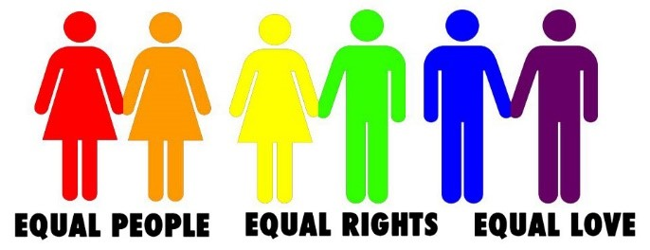
What does LGBT mean?
What is homophobic, biphobic and transphobic bullying?
What is Stonewall?

Slide 2

WHAT DOES LGBT STAND FOR?

Slide 3

Lesbian: refers to a woman who has an emotional, romantic and/or sexual orientation towards women
Gay: refers to a man who has an emotional, romantic and/or sexual orientation towards men. Also a generic term for lesbian and gay sexuality –some women deﬁne themselves as gay rather than lesbian
Bisexual: refers to a person who has an emotional, romantic and/or sexual orientation towards more than one gender
Trans: Trans is an umbrella term to describe people whose gender is not the same as, or does not sit comfortably with, the sex they were assigned at birth. Trans people may describe themselves using one or more of a wide variety of terms, including (but not limited to) transgender, cross dresser, non-binary and/or gender queer.

Slide 4


Stonewall is a charity set up in 1989 by a group of people who had been active in the struggle against Section 28 of the Local Government Act. Section 28 was designed to prevent the so-called 'promotion' of homosexuality in schools; as well as stigmatising lesbian, gay and bi people
Stonewall is renowned for its campaigning and lobbying. Some major successes include helping achieve the equalisation of the age of consent, lifting the ban on LGB people serving in the military, securing legislation which allowed same-sex couples to adopt and the repeal of Section 28. More recently, Stonewall has helped secure civil partnerships and then same-sex marriage and ensured that the recent Equality Act protected lesbian, gay and bi people in terms of goods and services.
Stonewall’s work will only finish when everyone feels free to be who they are, wherever they are.

Slide 5
Why is the work that Stonewall does so important?
https://www.youtube.com/watch?v=Vj1e91EutJo – Stonewall celebrates 25 years
https://www.youtube.com/watch?v=-9V73GQ_5ZU – Jak’s story

Slide 6


Beechen Cliff is a Stonewall Champion school, which means that we are committed to tackling homophobia, biphobia and transphobia in order to make Beechen Cliff a place where everyone is accepted without exception.

Slide 7
SO, WHAT ABOUT LGBT AND BULLYING?
The Stonewall School Report 2017 found that:
Nearly half of all LGB young people face bullying at school for being LGB. More than 60% of trans young people have experienced bullying for being trans.
While there has been some improvement in tackling homophobic, biphobic and transphobic bullying there is still work to be done:
  More than 4 in 5 trans young people have thought about or have hurt themselves in some way. This is compared to 3 in 5 LGB young people who do not identify as trans

Slide 8
Ninety nine per cent of lesbian, gay and bisexual young people hear the phrases ‘that’s so gay’ or ‘you’re so gay’ in school
Homophobic, biphobic and transphobic language includes language, jokes or ‘banter’ that is negative or disrespectful of, or that perpetuates stereotypes about, LGBT people. This is a form of bullying.
It is our responsibility to make sure this type of bullying and discrimination does not happen at Beechen Cliff.

Slide 9






What is the message behind these posters?

Slide 10

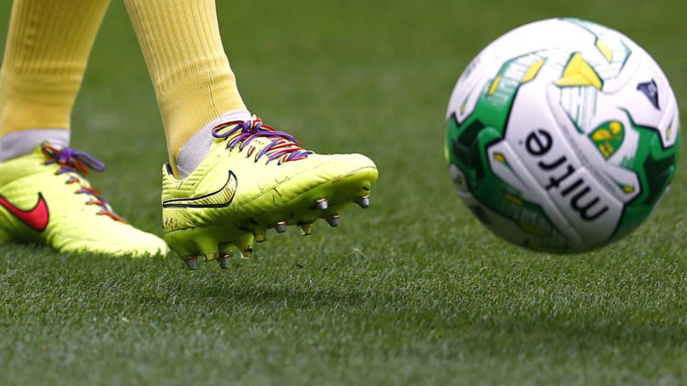
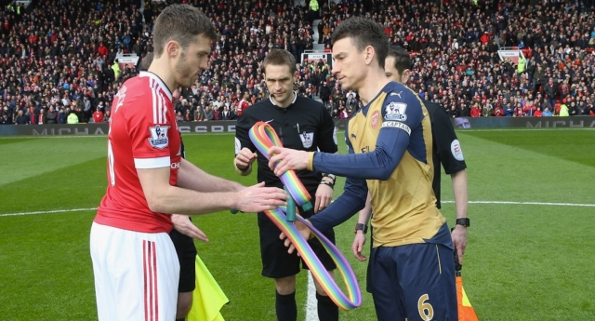
Every year, Stonewall encourages sports teams to wear rainbow laces
The campaign aims to show that everyone should be accepted without exception, in every area of life
The campaign takes place from 24th November until 3rd December this year, with Liverpool set to show their support before and during the match against Chelsea at Anfield – 25th November 2017
The captain will be wearing a rainbow armband and players will be wearing rainbow laces - there will also be a rainbow flag carried on to the pitch.
Simon Thornton, Equality & Diversity Officer at Liverpool FC, commented: “We are proud to be supporting the Rainbow Laces campaign again this year and helping to promote inclusion, equality and diversity in sport. This is something that the Club is really passionate about and continues to work hard at making advances in.”

Slide 11
WHAT CAN WE ALL DO?
Hear, don’t just listen to what people say and tell you
Respect every persons right to privacy
Ask how a person would like to be referred to and follow their wishes
Think about what you’re saying, if you think it’s offensive, don’t say it!
Don’t ask too many questions, especially not personal ones
Report incidents of bullying, even if they didn’t happen to you – to HoH, tutors, Mr Mann etc…
Remember – discrimination is against the law!
Notes:
This final slide is a call to action – What can we all do to make the experiences of trans young people better? Here are a few suggestions with explanations.
We all have a responsibility to ensure all people are protected and treated equally in our school community. Here are some practical ways to help support people who might be different to you. Some of these people might be trans, some might not. These practical suggestions can help us all to support LGBT people more effectively and be there for everyone in our community.
Firstly, hear don’t just listen; take the time to process what a person is saying to you and take it on board, don’t just let it go in one ear and out of the other.
Secondly, respect every person’s right to privacy. Just because they’ve told you something doesn’t mean they want everyone to know.
Thirdly, if you do meet a trans person, ask how they would like to be known and respect their wishes. Try and get it right, if you slip up, apologize.
Fourthly, think about what you’re saying. It’s likely that you’ll know something is offensive before you say it but if in doubt, don’t say it.
Additionally, don’t ask too many questions. People will come to you when they’re ready and they may or not share information with you that is personal to them. Don’t be offended if they don’t, just be patient and be led by what the people around you want.

Slide 12
Look out for the E Team and Sixth Form raising awareness and organising campaigns on behalf of Stonewall. To get involved – speak to an E Team member or Miss Netto

Slide 13
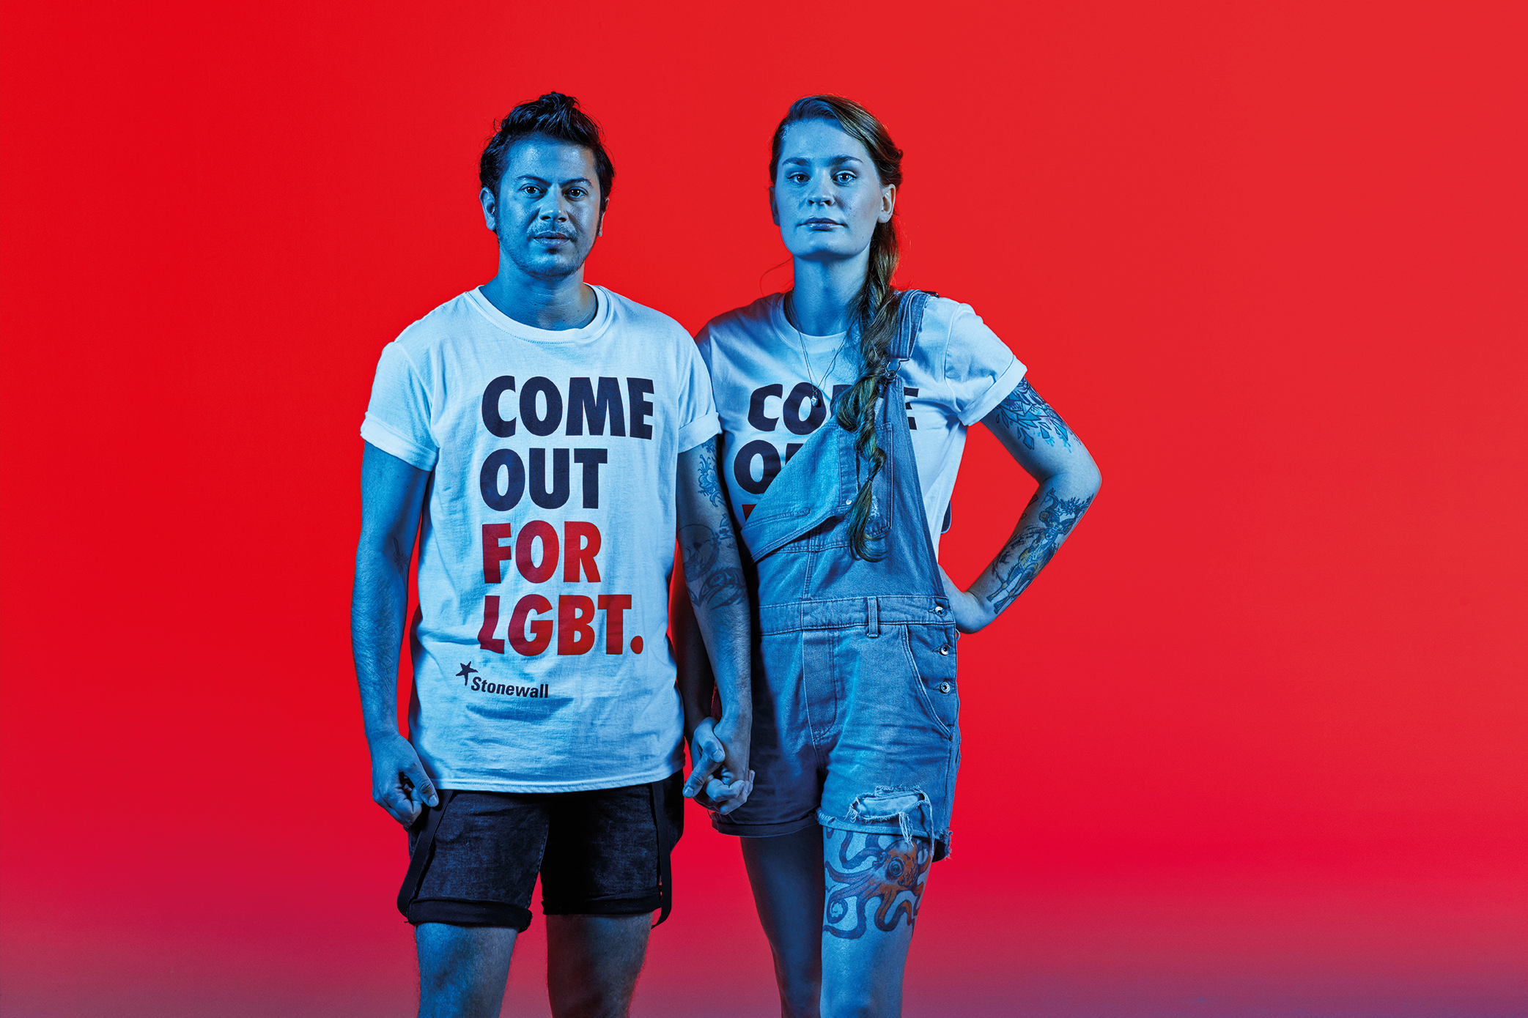
Finally, Be an ally –
#comeoutforlgbt
“I hope people realise that standing up for rights – not just LGBT rights but human rights in general – is just common sense, part of common decency.
It’s not enough that just one group gets what they need. Equality can’t leave anyone behind”.
Owl Fisher
(right of image)
Notes:
Finally, be an ally. This means being prepared to stand side by side LGBT people, even if you don’t identify as LGBT yourself. This could involve reporting an incident of bullying, even if it didn’t happen to you, or supporting the victim so they feel able to report it to someone who can help. Alternatively it could involve taking part in events and campaigns such as Stonewall’s #nobystanders or the brand new #comeoutforlgbt campaign. This could be both in and out of school and both provide opportunities to celebrate LGBT people and to stand by their sides. You could commit to working as part of the schools LGBT group or Equality and Diversity Team. We all have a part to play in making the world a fairer place for all people. As Owl says, “…standing up for rights – not just LGBT rights but human rights in general – is just common sense, part of common decency. It’s not enough that just one group gets what they need. Equality can’t leave anyone behind”.
No matter how different we are, we are all equal.
Thank you for listening.

