Slide 1
Parent Information Meeting
Alun Williams – CEO of MNSP
Who are we and what are we trying to achieve?
Why join the MNSP Trust?
What might be the benefits?
Timeline.
Questions from parents about the MNSP.

Slide 2
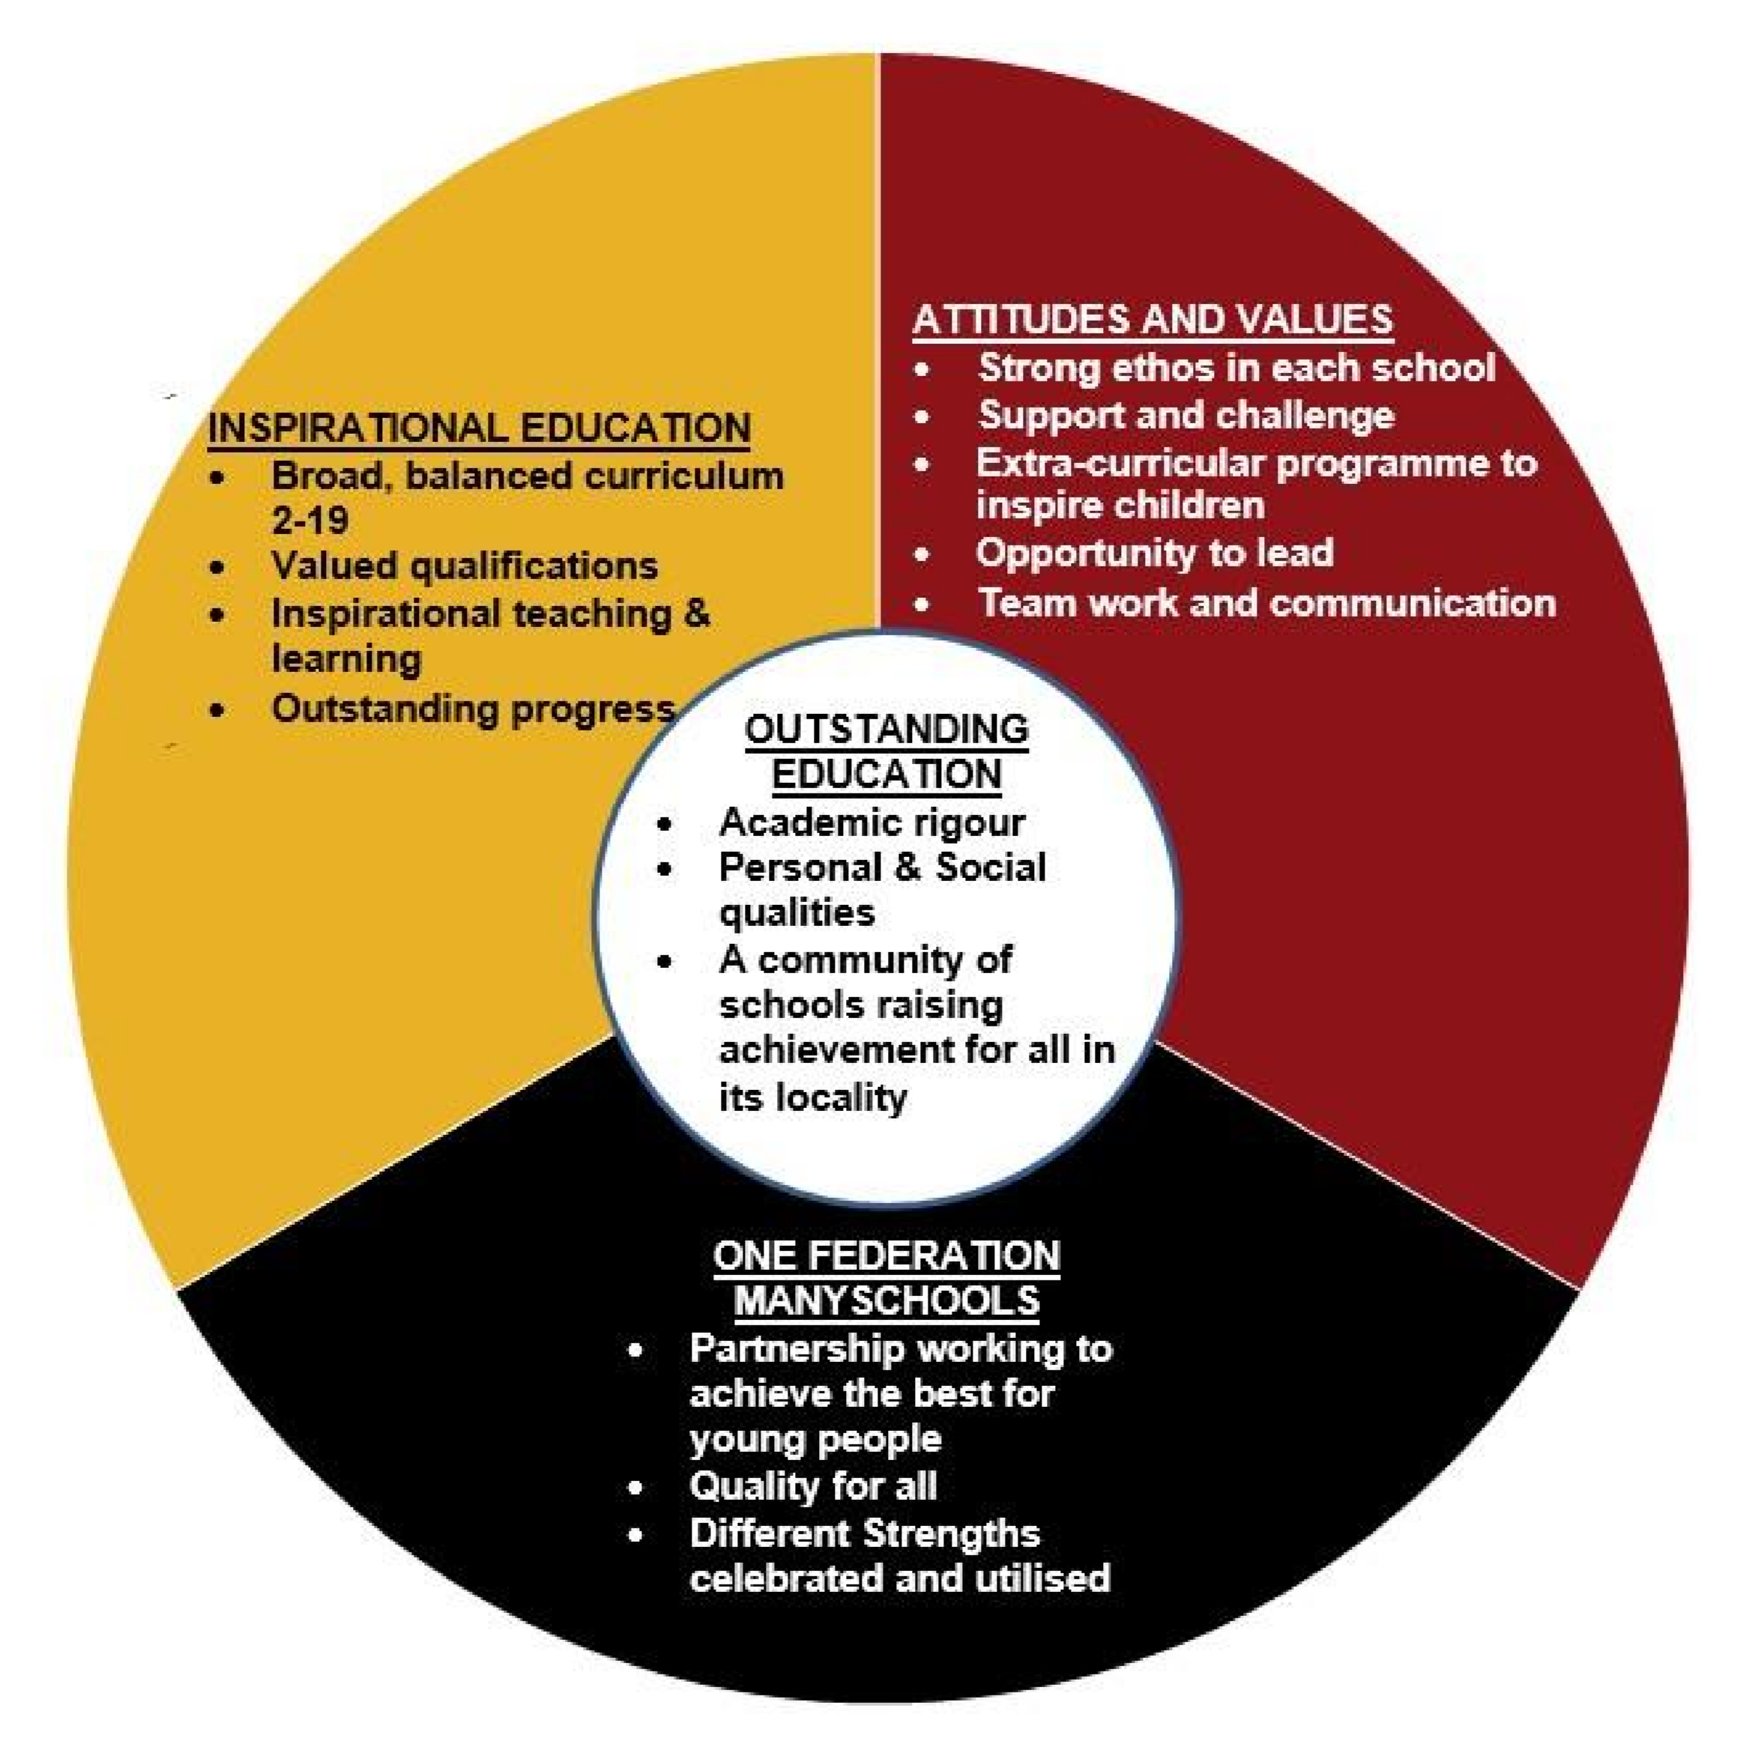
Vision for the Trust Schools
An underlining entitlement that all children should be able to attend a ‘good’ or better school, with school improvement as its principal focus.
No one school the same, but all with the dual aims of improving academic outcomes and supporting the development of personal and social qualities.
A curriculum in our schools that challenges children and one that emphasises extra-curricular involvement to broaden horizons.
Learning that is of the highest quality, stimulating and prepares children for life in modern Britain and builds resilience.
Where strong and structured collaboration is the driving force behind all that we do and keeps us all safe and secure .

Slide 3
Current Trust Schools:
School Name | Location | Sector | N.o.R. | %PP | Date of joining MAT | Current Ofsted rating 1-4 (with date)
Norton Hill Secondary School | MSN | Sec 11-18 | 1734 | 15% | 2009 | 2 (1 for behaviour/ safety (Jul 17)
Somervale Secondary School | MSN | Sec 11-18 | 559 | 28% | 2009 | 2
St Dunstan’s Secondary School | Glastonbury | Sec 11-16 | 330 | 28% | 2016 | 2
High Littleton (C of E) | High Littleton | Pri | 175 | 12% | 2014 | 1
Clutton (C of E) | Clutton | Pri | 135 | 13% | 2014 | 2
Trinity Church School (C of E) | Radstock | Pri /nur | 200 | 30% | 2015 | 2
Dundry primary (C of E) | Dundry | Pri | 90 | 10% | 2015 | N/A likely 2
Longvernal primary | MSN | Pri/nur | 155 | 29% | 2016 | 2 (1 for l and M)
Welton Primary | MSN | Pri | 200 | 26% | 2016 | 2
Farrington Gurney Pri (C of E) | FG | Pri | 90 | 5% | 2017 | 2
Midsomer Norton Primary | MSN | Pri/nur | 360 | 22% | 2017 | 2
Norton Hill Primary Free School (2019) | MSN | Pri | 630 | N/A | 2015 | N/A
Hemington primary | Hemington | Pri | 34 | 35% | 2018 | 2
Westfield primary | MSN | Pri | 512 | 20% | 2018 | 2
Leigh –on-Mendip First School | Leigh-on-Mendip | First School/nur | 60 | 11% | 2018 | 1

Slide 4
Successes and impact of the Trust:
These are wide-ranging and a full overview is available if required:
Outcomes at secondary are high over 3 year trend for all, groups and at GCSE and sixth form. St Dunstan’s has improved significantly (now a ‘good’) and SVS remains ‘good’ since joining the Trust.
Outcomes in primary schools have improved over time. Trinity, Welton, Clutton, Longvernal have all improved significantly.
Provision for children is improved including a better curriculum, improved facilities, improved support for children, e.g those with SEN.
School improvement is shared across the Trust schools, is more efficient and impact driven.
Staff training is done across the Trust and addresses common issues. Teachmeets, moderation, governor, TAs, clerking, finance, etc
Governance is improved at individual school level which is supporting leaders in schools.
Budgets will be balanced in 90% of the schools this year with £2 million in reserve.
OFSTED speak highly of the work done by the Trust – see recent inspection visits from Norton Hill, Somervale, Clutton, Trinity and St Dunstan’s.

Slide 5
Why be a partner with the MNSP Trust?
To bring about better-planned and more effective school improvement.
Safety in numbers – securing accountability and ensuring schools don’t miss information, national changes, etc.
To support improved collaboration across schools.
To reduce the burden on schools of policy, workload, service provision, etc.
To gain economies of scale and invest more in frontline education.
To avoid national MAT takeovers.

Slide 6
Benefits of joining the Trust:
Opportunity for children – SEN/able pupil/middle ability pupil provision, etc.
Better opportunities and training for staff.
High quality school improvement.
Economies of scale – buying power, staffing.
Support for when things go wrong.
Advice and guidance in tricky situations – legal, personnel, etc.

Slide 7
Benefits of joining the Trust:
Shared work on the curriculum, on pastoral care initiatives, etc.
Shared leadership work at senior level and middle leader level.
Shared knowledge and work at subject level 50 maths teachers working together rather than 12!
Pooling of some finances – capital monies predicted to be close to 1 million a year, etc.

Slide 8
Possible concerns you may have:
Will the culture and ethos of Beechen Cliff be eroded?
Will the Governors/Headteacher lose all their/his autonomy?
Will there be a loss of money?
Will the Trust be overly bureaucratic?
Who holds the Trust to account?
Will the rich diet of extra-curricular work at the Beechen Cliff continue?

Slide 9
Questions?

Slide 10
Why MNSP given that most of its schools are primaries?
Most local Trusts have more primary schools than secondary schools.
MNSP has 3 secondary schools currently (more than most local MATs) and is due to have 6 by the end of 2020. Norton Hill in particular is a very similar school to Beechen Cliff in terms of its ethos, academic outcomes and focus on core traditional values – therefore MNSP is a good fit.
Working with us avoids national MATs that would likely not wish to preserve the ethos/character of the school.

Slide 11
Many MATs benefit from centralisation of some support functions such as Finance, HR, IT etc. - is that the intention here?
Yes, absolutely. The MAT has central teams in the following areas that will be available to Beechen Cliff:
School improvement
Finance and audit
Estates
Personnel and HR
Catering
Educational welfare
Legal

Slide 12
Many MATs also benefit from some sharing and standardisation of teaching and learning resources (eg staff, methodologies, training, curriculum, internal exam setting). To what extent is that the case here?
Yes, this is true and yes we intend to maximise the benefit of good collaboration. However, we expect schools to be separate entities and see the MAT as a facilitator supporting schools to achieve their vision – different to other larger MATs – Oasis for example.
Some sensible standardisation is useful to support the wider work of the MAT, for example: exam boards, data systems, some aspects of training, etc.
Most elements of school are for the headmaster or governors to determine – the curriculum for example.

Slide 13
Does joining MNSP have any material financial implications - either positive or negative?
Yes, there is a financial implication. All schools pay a 4% top slice to maintain the central services including school improvement. In most cases, schools gain from this arrangement as they have ‘free’ access to services that they themselves would have to broker – legal support for example. I do not anticipate that Beechen will be ‘out of pocket’ significantly.
Additionally, as a relatively large MAT, we have an annual capital allowance which we estimate will be 1.3 million per year going forward. This is for maintaining and improving the estate.

Slide 14
How will the role of the Governing Body change as a result of joining MNSP?
Although the Governing Body is no longer the legal entity, its responsibilities remain the same in most aspects. The LGB is still responsible for standards, school improvement, managing the budget, the reserve, safeguarding, etc.
The Trust will intervene if it feels the LGB are not discharging these duties effectively. We have not had to do that yet in any school!

Slide 15
How much ‘independence’ will Beechen Cliff lose as a result of joining MNSP?
Very little if the school is performing well and acting appropriately. The Trust is set up to support schools to realise their vision for the children in their community. The Trust can also do some of the ‘heavy lifting’ when things go wrong and support the school.
Clearly Beechen Cliff will receive school improvement support, but will also be able to provide support for other schools which is healthy for staff and children.

Slide 16
How will the budget be allocated — will this be BC’s priorities or those of the MNSP? Aligned to this, how will funds raised by PTA or parents support be targeted at Beechen activities and priorities and not go into one big MNSP ‘pot’?
The budget is allocated in the same way as it is now. The Trust is the ‘lender of last resort’ however, which protects the school. The Local Governing Body and Head determine the spending and provided this is sensible and legal, the Trust do not interfere.
PTA funds stay with the school. – there is no ‘big pot’, except for the 4% top slice.

Slide 17
How will Beechen ensure that staff on the payroll are NOT transferred to other schools within MNSP according to ’needs’ identified by the MNSP team and without consultation with BC? Likewise, how will you ensure that staff from other schools are not foisted onto the payroll and roster at Beechen; I’m especially interested to know where this could impinge on BC budget?
Beechen Cliff staff and indeed all staff in the Trust, have a named school on their contract. Any staff moves are for promotion or experience and are driven by the staff and schools themselves. We probably do 10-15 a year.
The budget should not be impacted upon, but if it is then the Trust compensates for it.

Slide 18
How will BC determine its priorities for teaching and the way the curriculum is prioritised/taught? How will you ensure that there is not an overwhelming drive to results that leads to reduced outcomes for individuals?
The way children are taught and the curriculum is the responsibility of the school not the Trust – provided it is legal.

Slide 19
How will Beechen’s involvement not bolster any failing schools within MNSP - what are the other schools and what OFSTED ranking do they currently have (is Beechen going to be the ‘apple in the eye’ of the MNSP)????? I think for most parents and carers, the MNSP is not something that we have any knowledge of to date (why would we?).
MNSP has no failing schools. All schools are graded Ofsted ‘good’ or better. We have however moved two ‘special measures’ schools to ‘good’ in the last year.
Results at the secondary schools are strong as well. For example, Norton Hill matches or exceeds Beechen Cliff in terms of outcomes each year (even when looking only at boys!). The relationship I hope that we can create is one where we can collaborate to improve opportunity and outcomes for all children.
Despite the OFSTED judgement – we do view Beechen Cliff as a strong partner and a strong school. But it will not be the ‘apple in the eye’ as suggested. There are plenty of other high performing schools in the Trust already.

Slide 20
How will you ensure the intake and budget for Beechen is maintained given its participation within MNSP? The removal of the independence - and all that it represented to parents and pupils - is critical here.
See the Trust as the facilitator, able to support Beechen Cliff to make its vision a reality. There is no desire to change that vision and neither have we done this when other schools have joined MNSP.

